Slide 1
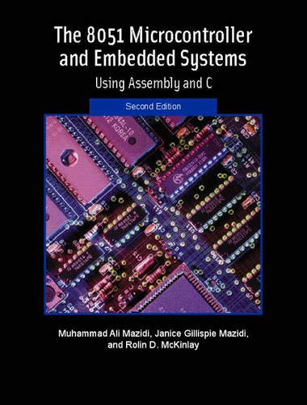
THE 8051
MICROCONTROLLER & Embedded Systems
Muhammad Ali Mazidi, Janice Mazidi
& Rolin McKinlay

Slide 2
INTERRUPTS
PROGRAMMING
IN ASSEMBLY AND C
Chapter 11

Slide 3
Objectives
Upon completion of this chapter, you will be able to:
>> Contrast and compare interrupts versus polling
>> Explain the purpose of the ISR (interrupt service routine)
>> List the 6 interrupts of the 8051
>> Explain the purpose of the interrupt vector table
>> Enable or disable 8051/52 interrupts
>> Program the 8051/52 timers using interrupts
>> Describe the external hardware interrupts of the 8051/52
>> Contrast edge-triggered with level-triggered interrupts
>> Program the 8051 for interrupt-based serial communication
>> Define the interrupt priority of the 8051
>> Program 8051/52 interrupts in C

Slide 4
Objectives
The concept of the interrupt and interrupt programming
Section 11.1, the basics of 8051 interrupts,
Section 11.2, the interrupts belonging to Timers 0 and 1,
Section 11.3, external hardware interrupts,
Section 11.4, the interrupt related to serial communication,
Section 11.5, interrupt priority in the 8051/52,
Section 11.6, C programming of 8051 interrupts

Slide 5
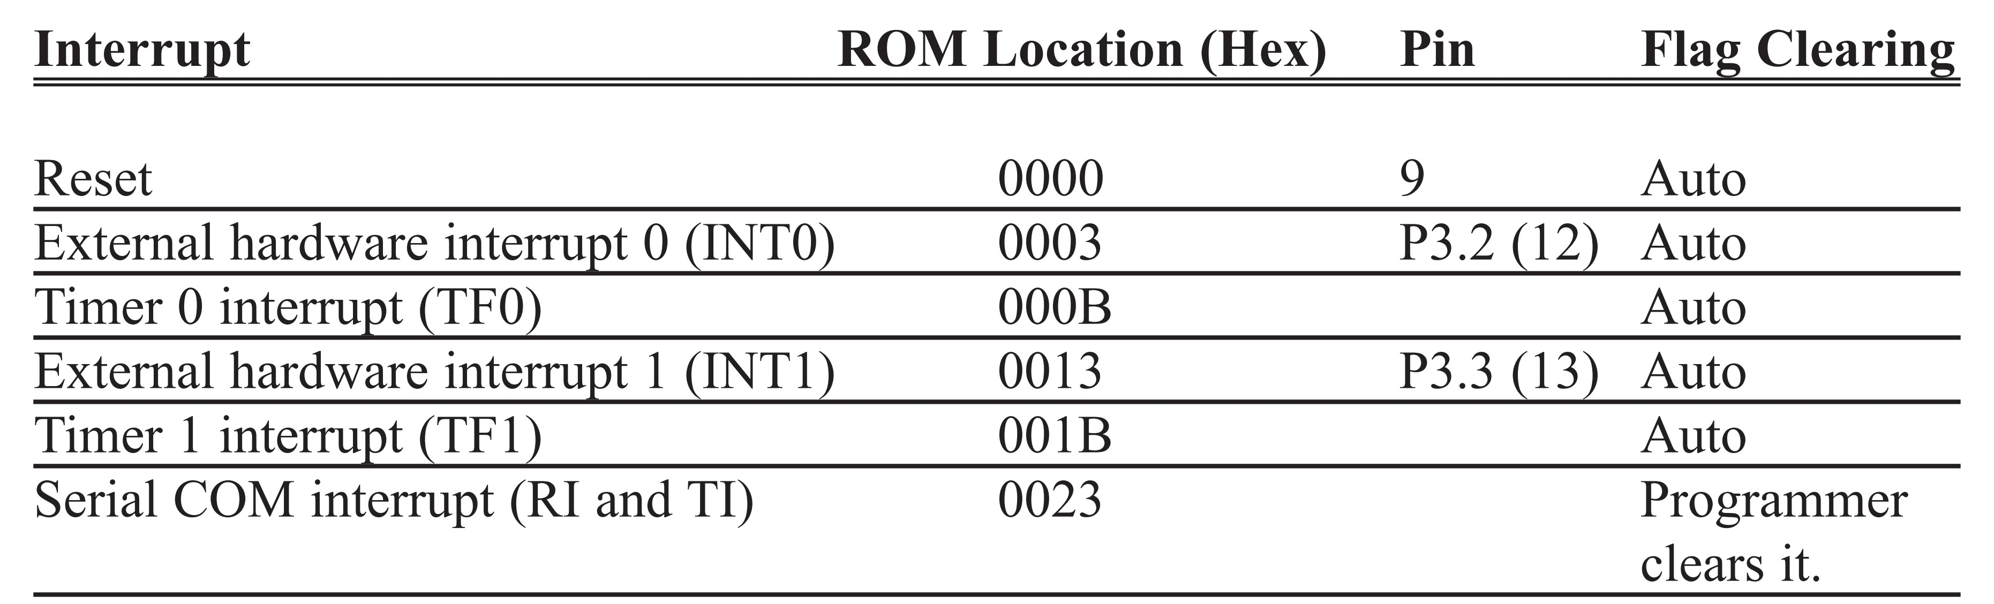
Table 11-1: Interrupt Vector Table for the 8051

Slide 6
Figure 11-1. Redirecting the 8051 from the Interrupt Vector Table at Power-up
ORG 0 ;wake-up ROM reset location
LJMP MAIN ;bypass interrupt vector table
;---- the wake-up program
ORG 30H
MAIN:
....
END

Slide 7
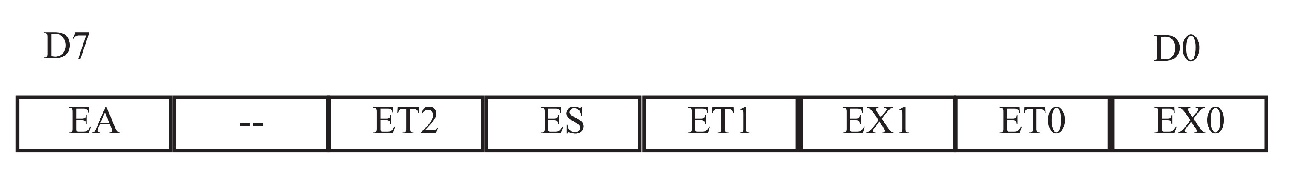
Figure 11-2. IE (Interrupt Enable) Register
EA IE.7 Disables all interrupts. If EA = 0, no interrupt is acknowledged.
If EA = 1, each interrupt source is individually enabled or disabled
by setting or clearing its enable bit.
-- IE.6 Not implemented, reserved for future use.*
ET2 IE.5 Enables or disables Timer 2 overflow or capture interrupt (8052 only).
ES IE.4 Enables or disables the serial port interrupt.
ET1 IE.3 Enables or disables Timer 1 overflow interrupt.
EX1 IE.2 Enables or disables external interrupt 1.
ET0 IE.1 Enables or disables Timer 0 overflow interrupt.
EX0 IE.0 Enables or disables external interrupt 0.
*User software should not write 1s to reserved bits. These bits may be used
in future flash microcontrollers to invoke new features.

Slide 8
Example 11-1
Show the instructions to (a) enable the serial interrupt, Timer 0 interrupt, and external hardware interrupt 1 (EX1), and (b) disable (mask) the Timer 0 interrupt, then (c) show how to disable all the interrupts with a single instruction.
Solution:
(a)MOV IE,#10010110B ;enable serial, Timer 0, EX1
Since IE is a bit-addressable register, we can use the following instructions to access individual bits of the register.
(b)CLR IE.1 ;mask(disable) Timer 0 interrupt only
(c)CLR IE.7 ;disable all interrupts
Another way to perform the “MOV IE,#10010110B” instruction is by using single-bit instructions as shown below.
SETBIE.7 ;EA=1, Global enable
SETB IE.4 ;enable serial interrupt
SETB IE.1 ;enable Timer 0 interrupt
SETB IE.2 ;enable EX1

Slide 9
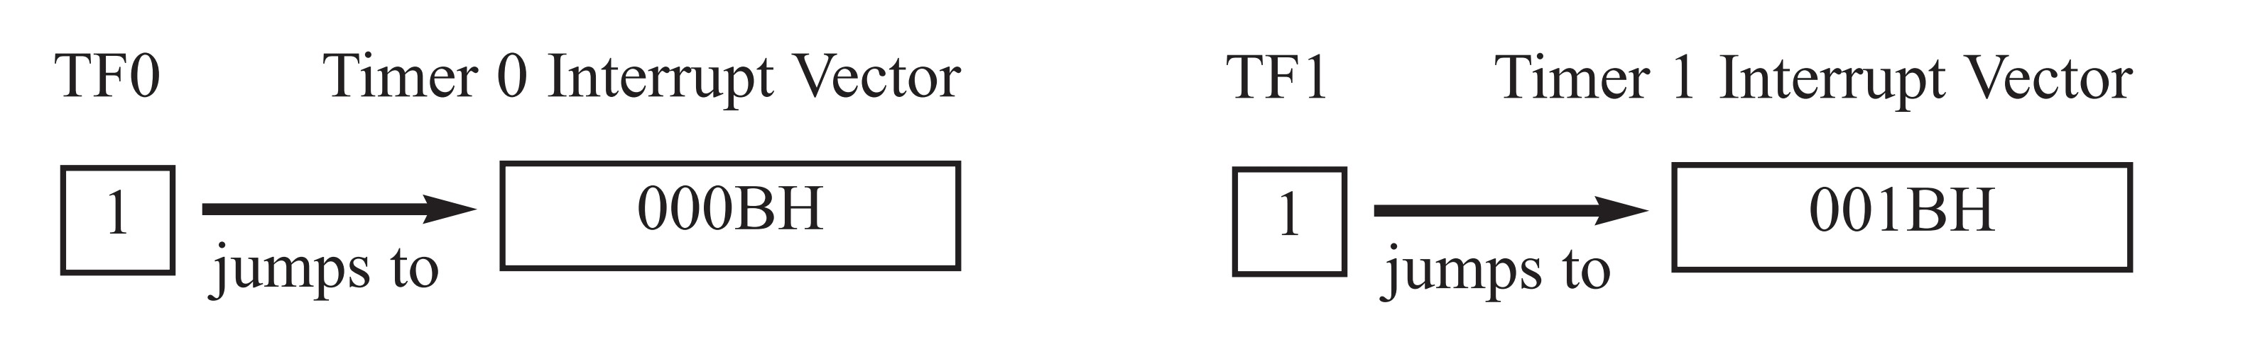
Figure 11-3. TF Interrupt

Slide 10
Example 11-2
Solution:
We will use Timer 0 in mode 2 (auto-reload). TH0 = 100/1.085 ms = 92.
;—-Upon wake-up go to main, avoid using memory space ;allocated to Interrupt Vector Table
ORG 0000H
LJMP MAIN ;bypass interrupt vector table
;
;—-ISR for Timer 0 to generate square wave
ORG 000BH ;Timer 0 interrupt vector table
CPL P2.1 ;toggle P2.1 pin
RETI ;return from ISR
;
;—-The main program for initialization
ORG 0030H ;after vector table space
MAIN: MOV TMOD,#02H ;Timer 0, mode 2(auto-reload)
MOV P0,#0FFH ;make P0 an input port
MOV TH0,#-92 ;TH0=A4H for -92
MOV IE,#82H ;IE=10000010(bin) enable Timer 0
SETB TR0 ;Start Timer 0
BACK: MOV A,P0 ;get data from P0
MOV P1,A ;issue it to P1
SJMP BACK ;keep doing it
;loop unless interrupted by TF0
END
Write a program that continuously gets 8-bit data from P0 and sends it to P1 while simultaneously creating a square wave of 200 ms period on pin P2.1.
Use Timer 0 to create the square wave.
Assume that
XTAL = 11.0592 MHz.

Slide 11
Since 1085 µs is 1000 x 1.085 we need to use mode 1 of Timer 1.
;--Upon wake-up go to main, avoid using memory space
;--allocated to Interrupt Vector Table
Example 11-3
Solution:
ORG 0000H
LJMP MAIN ;bypass interrupt vector table
;
;--ISR for Timer 1 to generate square wave
ORG 001BH ;Timer 1 interrupt vector table LJMP ISR_T1 ;jump to ISR
;
;--The main program for initialization
ORG 0030H ;after vector table
MAIN: MOV TMOD,#10H ;Timer 1, mode 1
MOV P0,#0FFH ;make P0 an input port
MOV TL1,#018H ;TL1=18 the Low byte of -1000
MOV TH1,#0FCH ;TH1=FC the High byte of -1000
MOV IE,#88H ;IE=10001000 enable Timer 1 int.
SETB TR1 ;start Timer 1
BACK: MOV A,P0 ;get data from P0
MOV P1,A ;issue it to P1
SJMP BACK ;keep doing it
;
;--Timer 1 ISR. Must be reloaded since not auto-reload
ISR_T1: CLR TR1 ;stop Timer 1
CLR P2.1 ;P2.1=0, start of low portion
MOV R2,#4 ; 2 MC
HERE: DJNZ R2,HERE ;4x2 machine cycle(MC) 8 MC
MOV TL1,#18H ;load T1 Low byte value 2 MC
MOV TH1,#0FCH ;load T1 High byte value 2 MC
SETB TR1 ;starts Timer 1 1 MC
SETB P2.1 ;P2.1=1, back to high 1 MC
RETI ;return to main
END
Rewrite Example 11-2 to create a square wave that has a high portion of 1085 µs and a low portion of 15 µs.
Assume
XTAL = 11.0592 MHz.
Use Timer 1.

Slide 12
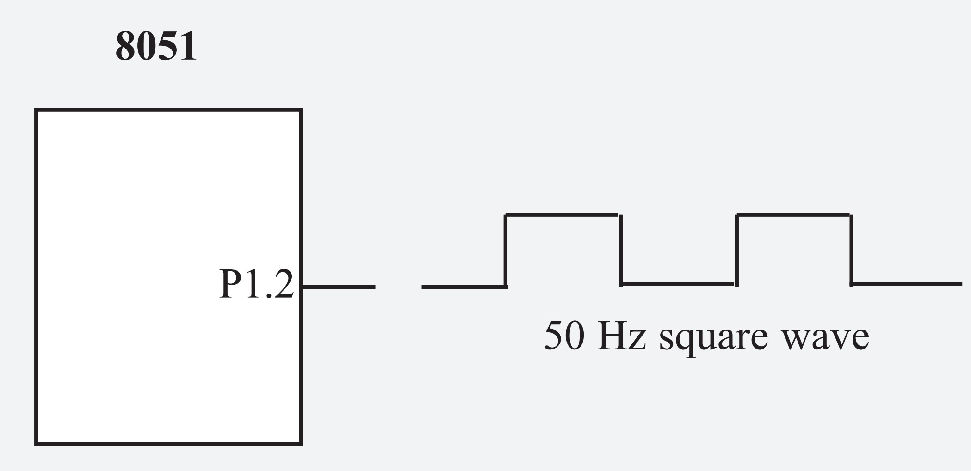
Example 11-4
Write a program to generate a square wave of 50 Hz frequency on pin P1.2. This is similar to Example 9-12 except that it uses an interrupt for Timer 0. Assume that XTAL = 11.0592 MHz.
Solution:
ORG 0
LJMP MAIN
ORG 000BH ;ISR for Timer 0
CPL P1.2 ;complement P1.2
MOV TL0,#00 ;reload timer values
MOV TH0,#0DCH
RETI ;return from interrupt
ORG 30H ;starting location for prog.
;------main program for initialization
MAIN: MOV TMOD,#00000001B ;Timer 0, Mode 1
MOV TL0,#00
MOV TH0,#0DCH
MOV IE,#82H ;enable Timer 0 interrupt
SETB TR0 ;start timer
HERE: SJMP HERE ;stay here until interrupted
END

Slide 13
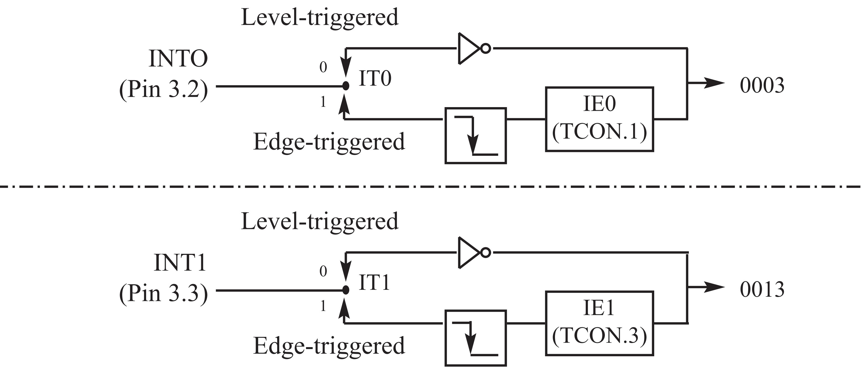
Figure 11-4. Activation of INT0 and INT1

Slide 14
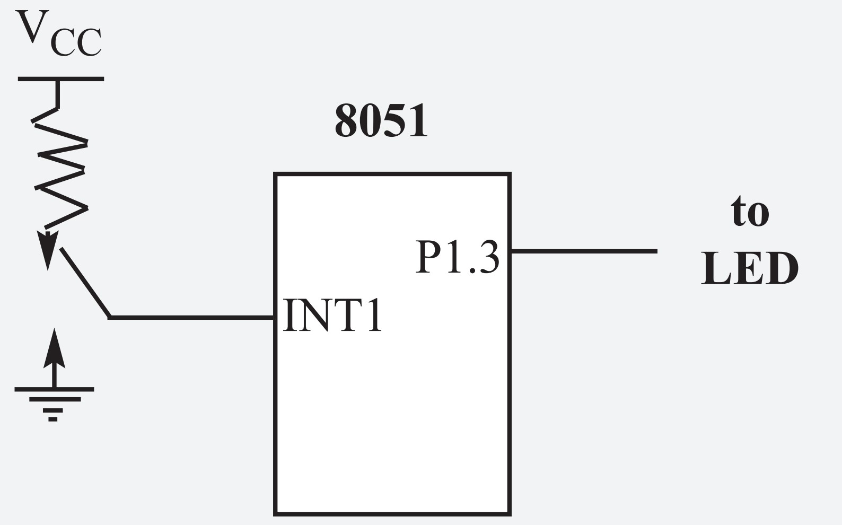
Example 11-5
Assume that the INT1 pin is connected to a switch that is normally high. Whenever it goes low, it should turn on an LED. The LED is connected to P1.3 and is normally off. When it is turned on it should stay on for a fraction of a second. As long as the switch is pressed low, the LED should stay on.
Solution:
ORG 0000H
LJMP MAIN ;bypass interrupt vector table
;--ISR for hardware interrupt INT1 to turn on the LED
ORG 0013H ;INT1 ISR
SETB P1.3 ;turn on LED
MOV R3,#255 ;load counter
BACK: DJNZ R3,BACK ;keep LED on for a while
CLR P1.3 ;turn off the LED
RETI ;return from ISR
;--MAIN program for initialization
ORG 30H
MAIN: MOV IE,#10000100B ;enable external INT1
HERE: SJMP HERE ;stay here until interrupted
END
Pressing the switch will turn the LED on. If it is kept activated, the LED stays on.

Slide 15
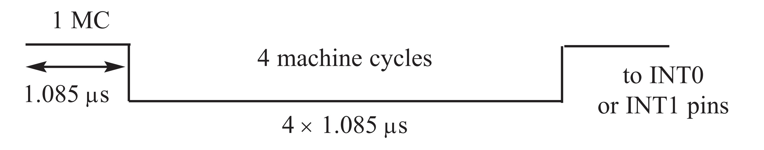
Figure 11-5. Minimum Duration of the Low Level-Triggered Interrupt (XTAL = 11.0592 MHz)
Note: On RESET, IT0 (TCON.0) and IT1 (TCON.2) are both low, making
external interrupts level-triggered.

Slide 16
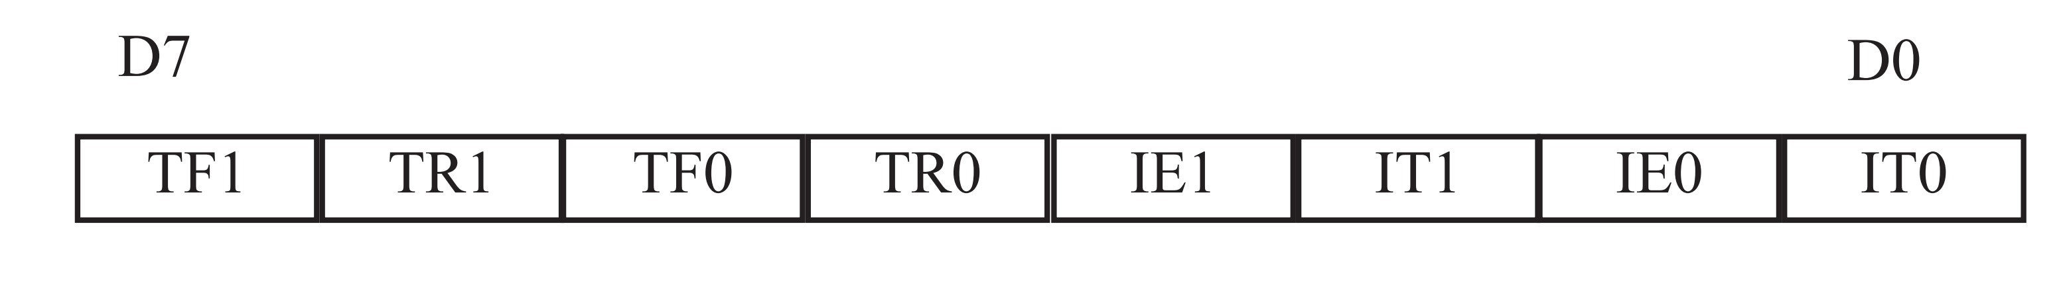
TF1 TCON.7 Timer 1 overflow flag. Set by hardware when timer/counter 1 overflows.
Cleared by hardware as the processor vectors to the interrupt service routine.
TR1 TCON.6 Timer 1 run control bit. Set/cleared by software to turn timer/counter 1 on/off.
TF0 TCON.5 Timer 0 overflow flag. Set by hardware when timer/counter 0 overflows.
Cleared by hardware as the processor vectors to the service routine.
TR0 TCON.4 Timer 0 run control bit. Set/cleared by software to turn timer/counter 0 on/off.
IE1 TCON.3 External interrupt 1 edge flag. Set by CPU when the external interrupt edge
(H-to-L transition) is detected.
Cleared by CPU when the interrupt is processed.
Note: This flag does not latch low-level triggered interrupts.
IT1 TCON.2 Interrupt 1 type control bit. Set/cleared by software to
specify falling edge/low-level triggered external interrupt.
IE0 TCON.1 External interrupt 0 edge flag. Set by CPU when external interrupt
(H-to-L transition) edge is detected. Cleared by CPU when interrupt is processed.
Note: This flag does not latch low-level triggered interrupts.
IT0 TCON.0 Interrupt 0 type control bit. Set/cleared by software to specify falling
edge/low-level triggered external interrupt.
Figure 11-6. TCON (Timer/Counter) Register (Bit-addressable)

Slide 17
Example 11-6
Assuming that pin 3.3 (INT1) is connected to a pulse generator, write a program in which the falling edge of the pulse will send a high to P1.3, which is connected to an LED (or buzzer). In other words, the LED is turned on and off at the same rate as the pulses are applied to the INT1 pin. This is an edge-triggered version of Example 11-5.
Solution:
ORG 0000H
LJMP MAIN
;--ISR for hardware interrupt INT1 to turn on the LED
ORG 0013H ;INT1 ISR
SETB P1.3 ;turn on the LED
MOV R3,#255
BACK: DJNZ R3,BACK ;keep the LED on for a while
CLR P1.3 ;turn off the LED
RETI ;return from ISR
;--MAIN program for initialization
ORG 30H
MAIN: SETB TCON.2 ;make INT1 edge-trigger interrupt
MOV IE,#10000100B ;enable External INT1
HERE: SJMP HERE ;stay here until interrupted
END

Slide 18
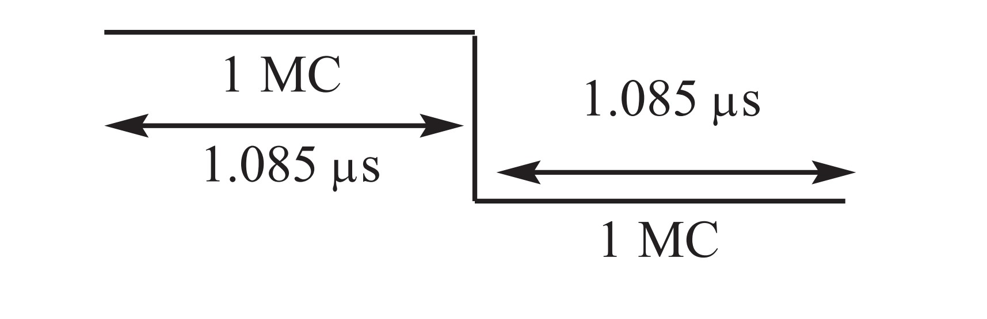
Minimum Pulse Duration to Detect Edge-triggered Interrupts. XTAL = 11.0592 MHz

Slide 19
Example 11-7
What is the difference between the RET and RETI instructions? Explain why we cannot use RET instead of RETI as the last instruction of an ISR.
Solution:
Both perform the same actions of popping off the top two bytes of the stack into the program counter, and making the 8051 return to where it left off. However, RETI also performs an additional task of clearing the interrupt-in-service flag, indicating that the servicing of the interrupt is over and the 8051 now can accept a new interrupt on that pin. If you use RET instead of RETI as the last instruction of the interrupt service routine, you simply block any new interrupt on that pin after the first interrupt, since the pin status would indicate that the interrupt is still being serviced. In the cases of TF0, TF1, TCON.1, and TCON.3, they are cleared by the execution of RETI.

Slide 20
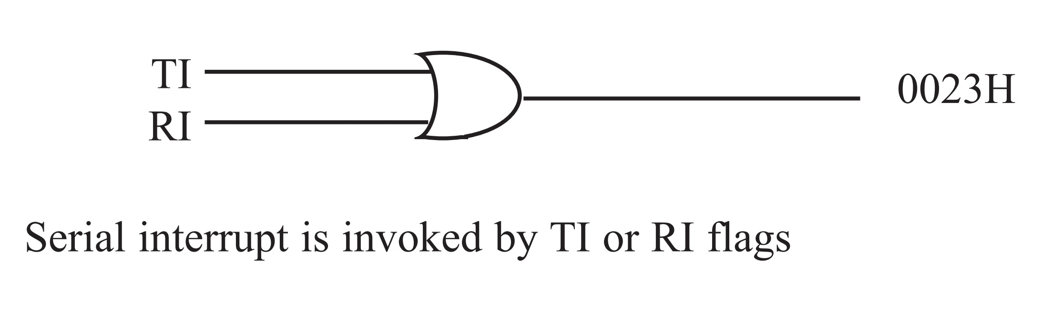
Figure 11-7. Single Interrupt for Both TI and RI

Slide 21
Write a program in which the 8051 reads data from P1 and writes it to P2 continuously while giving a copy of it to the serial COM port to be transferred serially.
Assume that XTAL = 11.0592 MHz. Set the baud rate at 9600.
Example 11-8
Solution:
ORG 0
LJMP MAIN
ORG 23H
LJMP SERIAL ;jump to serial interrupt ISR
ORG 30H
MAIN: MOV P1,#0FFH ;make P1 an input port
MOV TMOD,#20H ;timer 1, mode 2(auto-reload)
MOV TH1,#0FDH ;9600 baud rate
MOV SCON,#50H ;8-bit, 1 stop, REN enabled
MOV IE,#10010000B ;enable serial interrupt
SETB TR1 ;start timer 1
BACK: MOV A,P1 ;read data from port 1
MOV SBUF,A ;give a copy to SBUF
MOV P2,A ;send it to P2
SJMP BACK ;stay in loop indefinitely
;
;------------------Serial Port ISR
ORG 100H
SERIAL: JB TI,TRANS ;jump if TI is high
MOV A,SBUF ;otherwise due to receive
CLR RI ;clear RI since CPU does not
RETI ;return from ISR
TRANS: CLR TI ;clear TI since CPU does not
RETI ;return from ISR
END
In the above program notice the role of TI and RI. The moment a byte is written into SBUF it is framed and transferred serially. As a result, when the last bit (stop bit) is transferred the TI is raised, which causes the serial interrupt to be invoked since the corresponding bit in the IE register is high. In the serial ISR, we check for both TI and RI since both could have invoked the interrupt. In other words, there is only one interrupt for both transmit and receive.

Slide 22
Write a program in which the 8051 gets data from P1 and sends it
to P2 continuously while incoming data from the serial port is sent to P0.
Assume that XTAL = 11.0592 MHz. Set the baud rate at 9600.
Example 11-9
Solution:
ORG 0
LJMP MAIN
ORG 23H
LJMP SERIAL ;jump to serial ISR
ORG 30H
MAIN: MOV P1,#0FFH ;make P1 an input port
MOV TMOD,#20H ;timer 1, mode 2(auto-reload)
MOV TH1,#0FDH ;9600 baud rate
MOV SCON,#50H ;8-bit,1 stop, REN enabled
MOV IE,#10010000B ;enable serial interrupt
SETB TR1 ;start Timer 1
BACK: MOV A,P1 ;read data from port 1
MOV P2,A ;send it to P2
SJMP BACK ;stay in loop indefinitely
;------------------SERIAL PORT ISR
ORG 100H
SERIAL: JB TI,TRANS ;jump if TI is high
MOV A,SBUF ;otherwise due to receive
MOV P0,A ;send incoming data to P0
CLR RI ;clear RI since CPU doesn’t
RETI ;return from ISR
TRANS: CLR TI ;clear TI since CPU doesn’t
RETI ;return from ISR
END

Slide 23
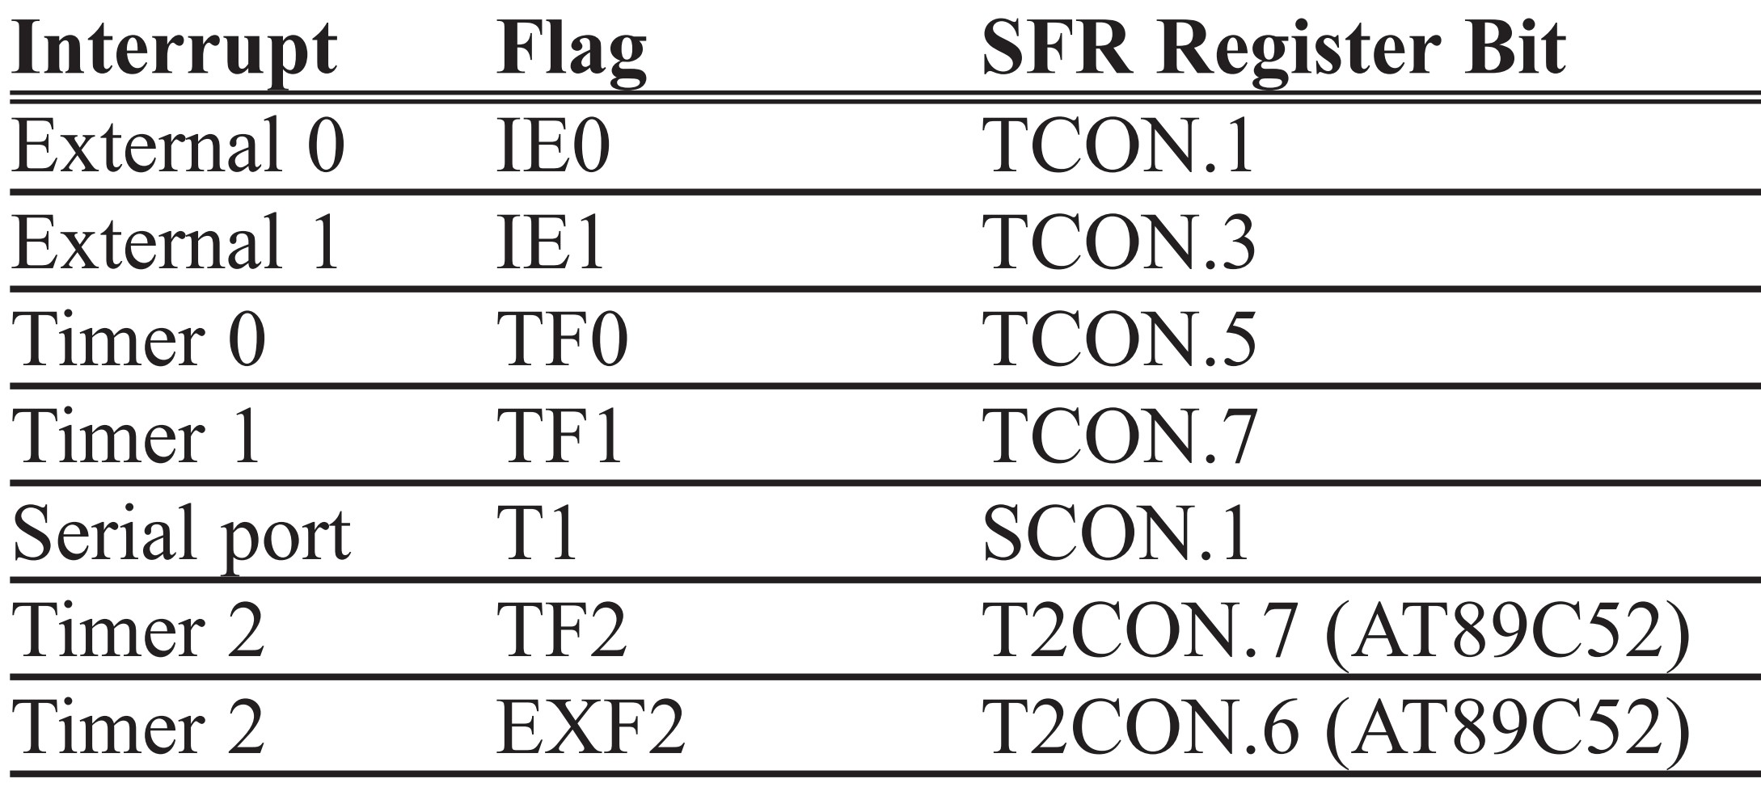
Table 11-2: Interrupt Flag Bits for the 8051/52

Slide 24
Write a program using interrupts to do the following: (a) Receive data serially and send it to P0, (b) Have port P1 read and transmitted serially, and a copy given to P2, (c) Make Timer 0 generate a square wave of 5 kHz frequency on P0.1. Assume that XTAL = 11.0592 MHz. Set the baud rate at 4800.
Example 11-10
Solution:
ORG 0
LJMP MAIN
ORG 000BH ;ISR for Timer 0
CPL P0.1 ;toggle P0.1
RETI ;return from ISR
ORG 23H
LJMP SERIAL ;jump to serial int. ISR
ORG 30H
MAIN: MOV P1,#0FFH ;make P1 an input port
MOV TMOD,#22H ;timer 0&1,mode 2, auto-reload
MOV TH1,#0F6H ;4800 baud rate
MOV SCON,#50H ;8-bit, 1 stop, REN enabled
MOV TH0,#-92 ;for 5 KHz wave
MOV IE,#10010010B ;enable serial, timer 0 int.
SETB TR1 ;start timer 1
SETB TR0 ;start timer 0
BACK: MOV A,P1 ;read data from port 1
MOV SBUF,A ;give a copy to SBUF
MOV P2,A ;write it to P2
SJMP BACK ;stay in loop indefinitely
;------------------SERIAL PORT ISR
ORG 100H
SERIAL: JB TI,TRANS ;jump if TI is high
MOV A,SBUF ;otherwise due to received
MOV P0,A ;send serial data to P0
CLR RI ;clear RI since CPU does not
RETI ;return from ISR
TRANS: CLR TI ;clear TI since CPU does not
RETI ;return from ISR
END

Slide 25
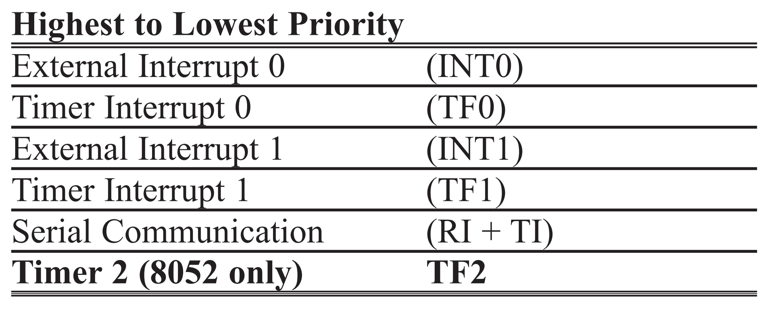
Table 11-3: 8051/52 Interrupt Priority Upon Reset

Slide 26
Example 11-11
Discuss what happens if interrupts INT0, TF0, and INT1 are activated at the same time. Assume priority levels were set by the power-up reset and that the external hardware interrupts are edge-triggered.
Solution:
If these three interrupts are activated at the same time, they are latched and kept internally. Then the 8051 checks all five interrupts according to the sequence listed in Table 11-3. If any is activated, it services it in sequence. Therefore, when the above three interrupts are activated, IE0 (external interrupt 0) is serviced first, then Timer 0 (TF0), and finally IE1 (external interrupt 1).

Slide 27
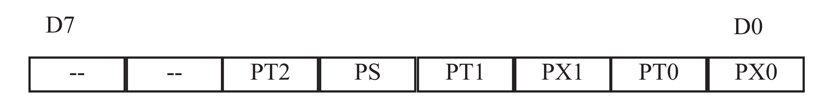
Figure 11-8. Interrupt Priority Register (Bit-addressable)
Priority bit = 1 assigns high priority. Priority bit = 0 assigns low priority.
-- IP.7 Reserved
-- IP.6 Reserved
PT2 IP.5 Timer 2 interrupt priority bit (8052 only)
PS IP.4 Serial port interrupt priority bit
PT1 IP.3 Timer 1 interrupt priority bit
PX1 IP.2 External interrupt 1 priority bit
PT0 IP.1 Timer 0 interrupt priority bit
PX0 IP.0 External interrupt 0 priority bit
User software should never write 1s to unimplemented bits, since they may be used in future products.

Slide 28
Example 11-12
(a) Program the IP register to assign the highest priority to INT1 (external interrupt 1), then (b) discuss what happens if INT0, INT1, and TF0 are activated at the same time. Assume that the interrupts are both edge-triggered.
Solution
(a) MOV IP,#00000100B ;IP.2=1 to assign INT1 higher priority
The instruction “SETB IP.2” also will do the same thing as the above line since IP is bit-addressable.
(b) The instruction in Step (a) assigned a higher priority to INT1 than the others; therefore, when INT0, INT1, and TF0 interrupts are activated at the same time, the 8051 services INT1 first, then it services INT0, then TF0. This is due to the fact that INT1 has a higher priority than the other two because of the instruction in Step (a). The instruction in Step (a) makes both the INT0 and TF0 bits in the IP register 0. As a result, the sequence in Table 11-3 is followed, which gives a higher priority to INT0 over TF0.

Slide 29
Example 11-13
Assume that after reset, the interrupt priority is set by the instruction “MOV IP, #00001100B”. Discuss the sequence in which the interrupts are serviced.
Solution
The instruction “MOV IP,#00001100B” (B is for binary) sets the external interrupt 1 (INT1) and Timer 1 (TF1) to a higher priority level compared with the rest of the interrupts. However, since they are polled according to Table 11-3, they will have the following priority.
Highest Priority External Interrupt 1 (INT1)
Timer Interrupt 1 (TF1)
External Interrupt 0 (INT0)
Timer Interrupt 0 (TF0)
Lowest Priority Serial Communication (RI + TI)

Slide 30
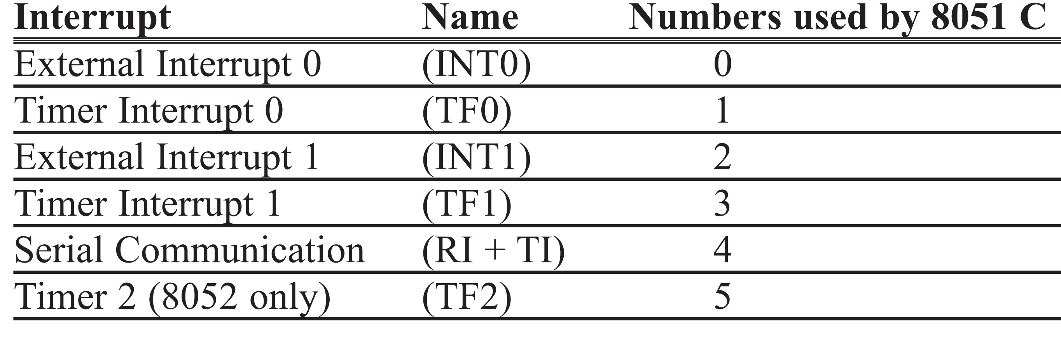
Table 11-4: 8051/52 Interrupt Numbers in C

Slide 31
Example 11-14
Write a C program that continuously gets a single bit of data from P1.7 and sends it to P1.0, while simultaneously creating a square wave of 200 µs period on pin P2.5. Use timer 0 to create the square wave. Assume that XTAL = 11.0592 MHz.
Solution:
We will use timer 0 in mode 2 (auto-reload). One half of the period is 100 µs.
100 /1. 085 ms = 92, and TH0 = 256 – 92 = 164 or A4H
#include <reg51.h>
sbit SW = P1^7;
sbit IND = P1^0;
sbit WAVE = P2^5;
void timer0(void) interrupt 1
{
WAVE = ~WAVE; //toggle pin
}
void main()
{
SW = 1; //make switch input
TMOD = 0x02;
TH0 = 0xA4; //TH0 = -92
IE = 0x82; //enable interrupts for timer 0
while(1)
{
IND = SW; //send switch to LED
}
}
200 µs / 2 = 100 µs
100 µs / 1.085 µs = 92

Slide 32
#include <reg51.h>
sbit SW = P1^7;
sbit IND = P1^0;
sbit WAVE = P2^5;
void timer0(void) interrupt 1
{
WAVE = ~WAVE; //toggle pin
}
void serial0() interrupt 4
{
if(TI == 1)
{
SBUF = 'A'; //send A to serial port
TI = 0; //clear interrupt
}
else
{
RI = 0; //clear interrupt
}
}
void main()
{
SW = 1; //make switch input
TH1 = -3; //9600 baud
TMOD = 0x22; //mode 2 for both timers
TH0 = 0xA4; //-92=A4H for timer 0
SCON = 0x50;
TR0 = 1;
TR1 = 1; //start timer
IE = 0x92; //enable interrupt for T0
while(1) //stay here
{
IND = SW; //send switch to LED
}
}
Example 11-15
Solution:
Write a C program that continuously gets a single bit of data from P1.7 and sends it to P1.0 in the main, while simultaneously (a) creating a square wave of 200 µs period on pin P2.5, and (b) sending letter ‘A’ to the serial port.
Use Timer 0 to create the square wave.
Assume that
XTAL = 11.0592 MHz.
Use the 9600 baud rate.
We will use Timer 0 in mode 2 (auto-reload). TH0 = 100/1.085 µs = –92, which is A4H

Slide 33
#include <reg51.h>
sbit WAVE = P0^1;
void timer0() interrupt 1
{
WAVE = ~WAVE; //toggle pin
}
void serial0() interrupt 4
{
if(TI == 1)
{
TI = 0; //clear interrupt
}
else
{
P0 = SBUF; //put value on pins
RI = 0; //clear interrupt
}
}
void main()
{
unsigned char x;
P1 = 0xFF; //make P1 an input
TMOD = 0x22;
TH1 = 0xF6; //4800 baud rate
SCON = 0x50;
TH0 = 0xA4; //5 kHz has T = 200 µs
IE = 0x92; //enable interrupts
TR1 = 1; //start timer 1
TR0 = 1; //start timer 0
while(1)
{
x = P1; //read value from pins
SBUF = x; //put value in buffer
P2 = x; //write value to pins
}
}
Example 11-16
Solution:
Write a C program using interrupts to do the following:
Receive data serially and send it to P0,
(b) Read port P1, transmit data serially, and give a copy to P2,
(c) Make timer 0 generate a square wave of 5 kHz frequency on P0.1.
Assume that
XTAL = 11.0592 MHz. Set the baud rate at 4800.

Slide 34
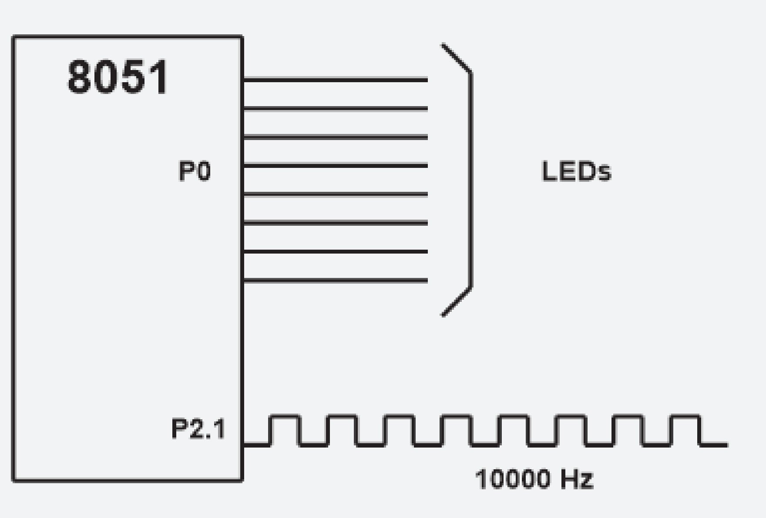
Write a C program using interrupts to do the following: (a) Generate a 10000 Hz frequency on P2.1 using T0 8-bit auto-reload, (b) Use timer 1 as an event counter to count up a 1-Hz pulse and display it on P0. The pulse is connected to EX1. Assume that XTAL = 11.0592 MHz. Set the baud rate at 9600.
Example 11-17
Solution:
#include <reg51.h>
sbit WAVE = P2^1;
unsigned char cnt;
void timer0() interrupt 1
{
WAVE = ~WAVE; //toggle pin
}
void timer1() interrupt 3
{
cnt++; //increment counter
P0 = cnt; //display value on pins
}
void main()
{
cnt = 0; //set counter to zero
TMOD = 0x42;
TH0 = 0x-46; //10000 Hz
IE = 0x86; //enable interrupts
TR0 = 1; //start timer 0
TR1 = 1; //start timer 1
while(1); //wait until interrupted
}
1 / 10000 Hz = 100 µs
100 µs / 2 = 50 µs
50 µs / 1.085 µs = 46

